Slide 1



SkillBridge
CAPSTONE PROJECT PRESENTATION
Track / Job Profile:
Data Analytics Track | Junior Data Analysis
Team:
LexiTech— Alaa Hussien | Rasha Wael | Fatma Ibrahim | Esraa Metwally
Supervisor:
Supervisor: Prof. Dr. Rania Elgohary | Track Head: Dr. Ahmed Zakaria |
Academic Team: Dr. Yasser Ali | Instructor: Eng.Haidy Seada
Submission:
September 2026

Slide 2
Agenda
01
Team Introduction
05
Technology Stack & Implementation
02
Problem Statement & Background
06
Demo & Results
03
Objectives & Scope
07
Impact & Future Work
04
Proposed Solution & Architecture
DiGiLiANS — Digital Pioneers Initiative | Capstone Project Defense 2026
2

Slide 3
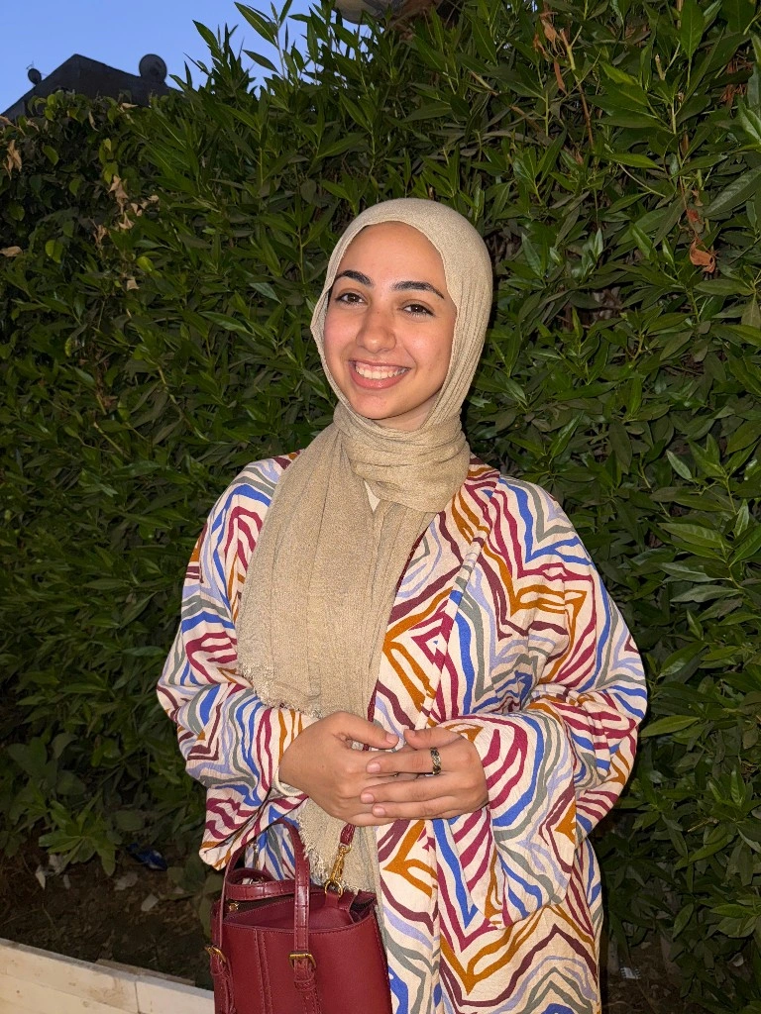
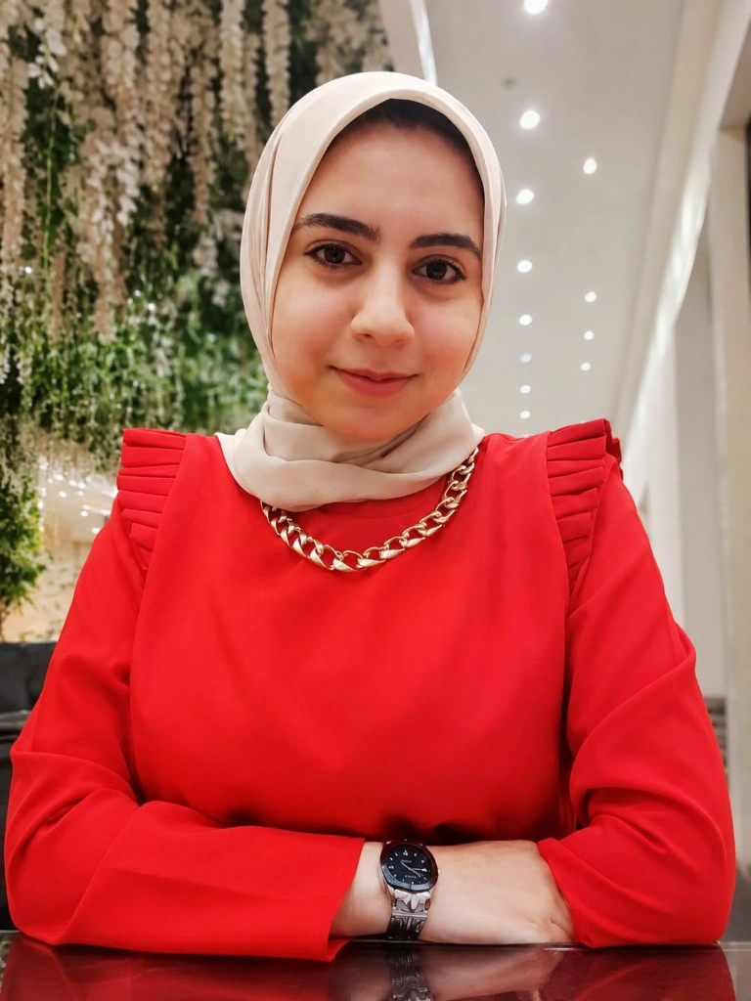


Team Introduction
Esraa Metwally Abo Elnasr
Fatma Ibrahim Morsy
Rasha Wael Ramadan
Alaa Hussien Mohamed
Project Coordinator & Dashboard Specialist
UI/UX & Dashboard Specialist
BI & Dashboard Specialist
Data Engineer & AI Specialist
Project Management, Dashboard Development, Presentation, and Reporting
Interface Design, Dashboard Layout, and Visual Analytics
Data Preparation, Power BI Modeling, DAX Measures, and Documentation
Web Scraping, EDA, ML Model Development, Data Cleaning, and Documentation
Supervisor: Prof. Dr. Rania Elgohary / Track Head: Dr. Ahmed Zakaria
DiGiLiANS — Digital Pioneers Initiative | Capstone Project Defense 2026
3

Slide 4
Problem Statement
Core Problem: Structural mismatch between pre-university/academic learning outcomes and real-world freelance market skill demands.
Key Challenges:
  Skill Misalignment: Difficulty evaluating skills based on true market demand versus talent saturation
  Market Friction & Competition: High job counts don't equal real opportunities when competition is intense.
  Pricing & Wage Ambiguity: Lack of objective benchmarks for setting accurate hourly/project rates.
  Why Solve It Now? To empower Egyptian youth, optimize national IT training investments, and reduce proposal friction for remote digital talent.
DiGiLiANS — Digital Pioneers Initiative | Capstone Project Defense 2026
4

Slide 5

Objectives & Project Scope
Objective 1: Build an end-to-end BI pipeline integrating 100K+ freelance job records.
Objective 2: Measure Skill Demand/Supply gaps using advanced DAX metrics and KPI frameworks.
Objective 3: Implement the Diamond Skills Finder to highlight high-value, low-competition skills.
Objective 4: Develop an ML CatBoost Salary Predictor achieving an $R^{2}$ >= 0.68 for hourly rate estimation.
Data Extraction (Web Scraping) and ETL Processing using Python & Pandas.
Relational Star Schema Data Modeling and interactive Power BI dashboards.
Machine Learning Wage Prediction Engine (CatBoost Regressor) deployed via FastAPI.
Multi-Stakeholder Intelligence (MCIT, Education Ministries, Academies, Freelancers).
SMART Objectives
What’s In Scope
DiGiLiANS — Digital Pioneers Initiative | Capstone Project Defense 2026
5

Slide 6
Proposed Solution
System Overview: SkillBridge – An integrated Data Analytics, Business Intelligence, and Machine Learning Framework connecting Education Skills Market Demand Earning Potential.
Core Capabilities:
  Market & Skill Intelligence: Real-time visibility into hiring trends, applicant density, and skill saturation.
  Diamond Skills Finder: Identifies high-margin technical skills with low market competition.
  ML Pricing Engine: Predicts accurate market-driven hourly rates based on project attributes.
  Unique Value Proposition: Bridges academic/initiative training outcomes with empirical freelance market metrics to optimize curriculum ROI.
DiGiLiANS — Digital Pioneers Initiative | Capstone Project Defense 2026
6

Slide 7
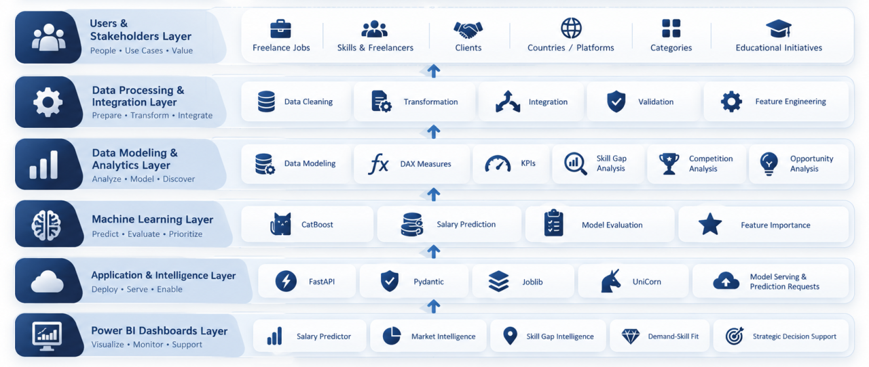
System Architecture
[ Insert Architecture Diagram Here ]
E.g. High-level component diagram showing frontend, backend, database,
apis, ML models, data pipelines, cloud services, or security layers
DiGiLiANS — Digital Pioneers Initiative | Capstone Project Defense 2026
7

Slide 8
Technology Stack
Frontend
Backend
Power BI Tabular Data Model
Structured Data Tables(Excel)
Database
Power BI Embedded / Dashboards
FastAPI Web UI / HTML5
Python
FastAPI & Uvicorn
Pandas & NumPy
AI / ML
Cloud & DevOps
Security
CatBoost Regressor
Scikit-Learn
Joblib (Model Serialization & Deployment)
GitHub
Power BI Service
Pydantic Validation
DiGiLiANS — Digital Pioneers Initiative | Capstone Project Defense 2026
8

Slide 9
System Requirements
Functional Requirements
Non-Functional Requirements
FR1: Extract, clean, and model freelance data across categories, countries, and platforms.
FR2: Dynamically compute Demand-Supply Ratios, Skill Gaps, and Competition Indices.
FR3: Provide interactive dashboards with cross-filtering for strategic decision support.
FR4: Predict expected hourly rates based on pre-publication job features.
Performance: Fast dashboard rendering and sub-second API prediction response time.
Methodological Integrity: Complete exclusion of post-publication variables (e.g., Applicants Count) to prevent Data Leakage.
Scalability: Robust architecture supporting 100K+ records and extensible data sources.
DiGiLiANS — Digital Pioneers Initiative | Capstone Project Defense 2026
9

Slide 10
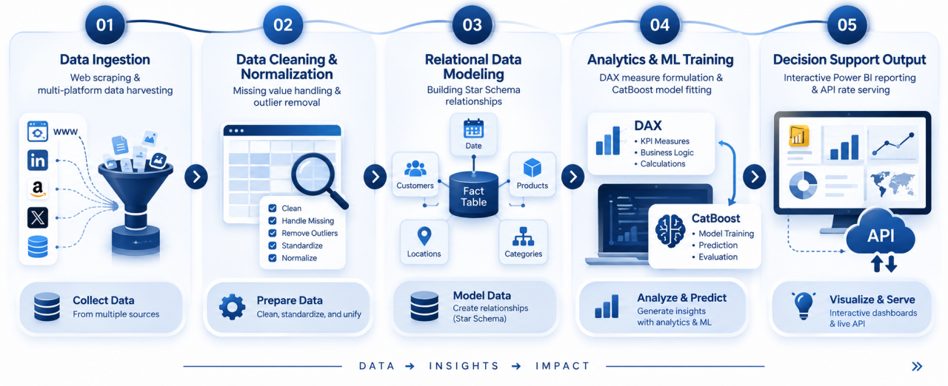
Workflow / Use Case Diagram
[ Insert Workflow Diagram or Use Case Diagram Here ]
Show main actors, system interactions, and process flow
(BPMN / UML Use Case / Sequence Diagram)
DiGiLiANS — Digital Pioneers Initiative | Capstone Project Defense 2026
10

Slide 11
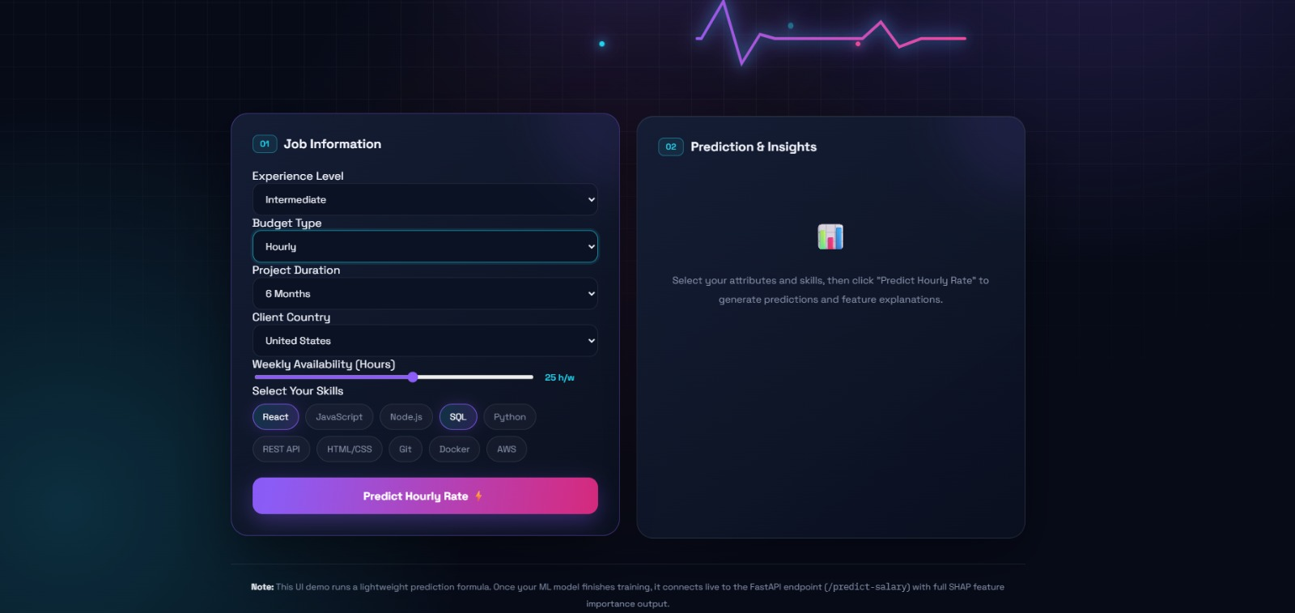
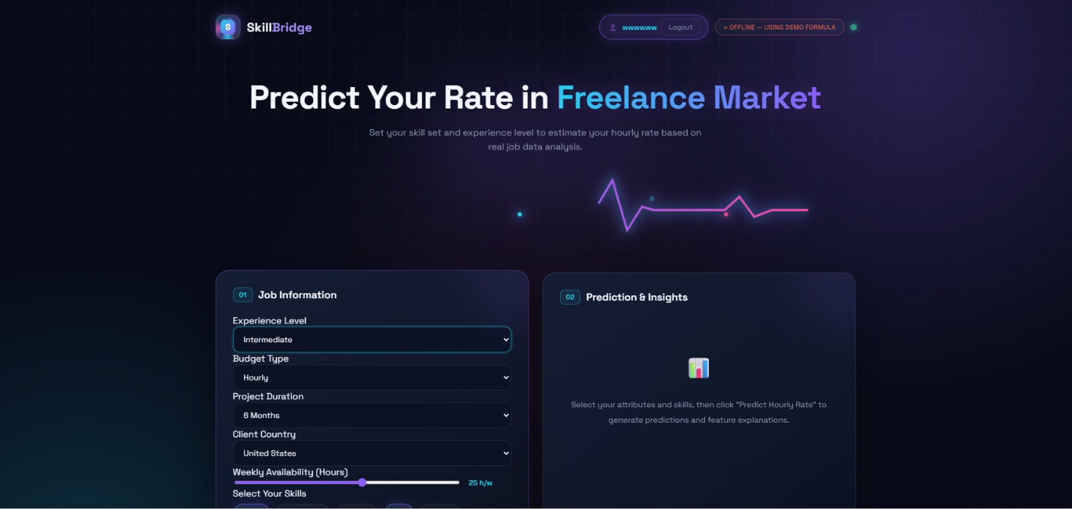
Implementation & Demo
Screenshot / Demo 1
[Insert UI screenshot or demo image here]
Screenshot / Demo 2
[Insert UI screenshot or demo image here]
Key highlights from the demo:
Live Demo Link / QR Code:
Live Rate Predictor: User-friendly UI estimating fair market hourly rates using CatBoost ML.
https://github.com/esraasalem2/skill-Bridge-
DiGiLiANS — Digital Pioneers Initiative | Capstone Project Defense 2026
11

Slide 12
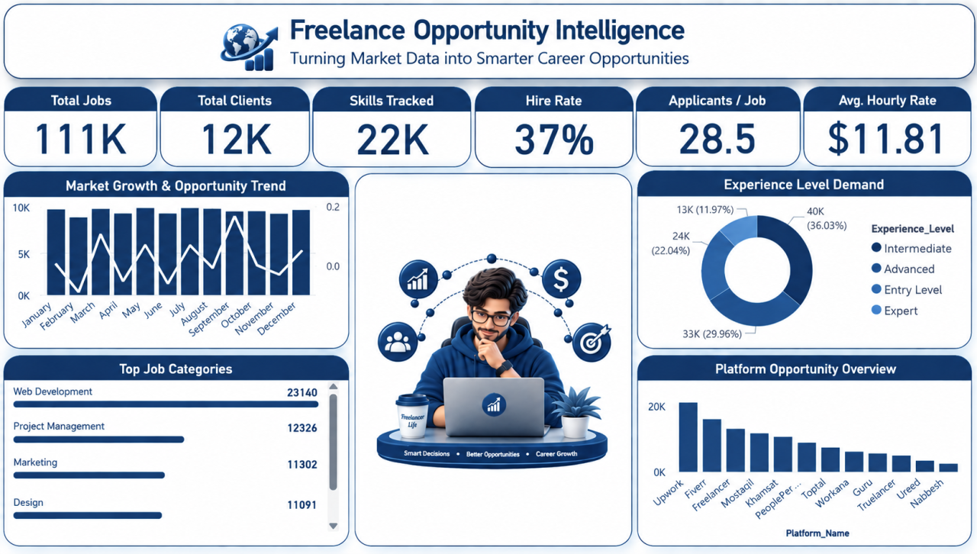
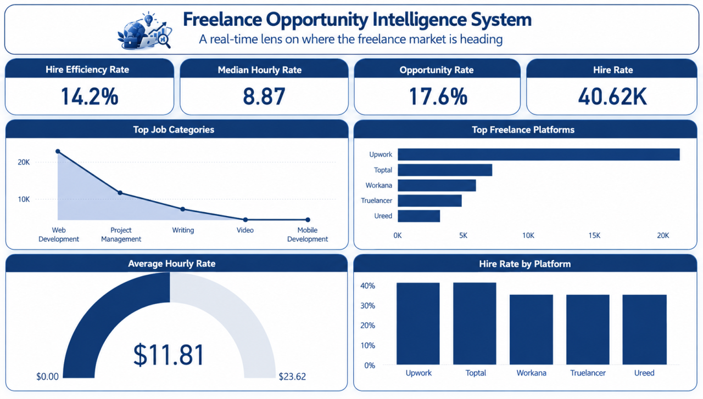
Implementation & Demo
Screenshot / Demo 1
[Insert UI screenshot or demo image here]
Screenshot / Demo 2
[Insert UI screenshot or demo image here]
Key highlights from the demo:
Live Demo Link / QR Code:
Market Intelligence Overview: Comprehensive analysis of 111K+ jobs, platforms, and client geographies.
Skill Gap & Diamond Skills Finder: Dynamic filtering pinpointing high-earning, low-competition skill sets.
https://github.com/esraasalem2/skill-Bridge-
DiGiLiANS — Digital Pioneers Initiative | Capstone Project Defense 2026
11

Slide 13
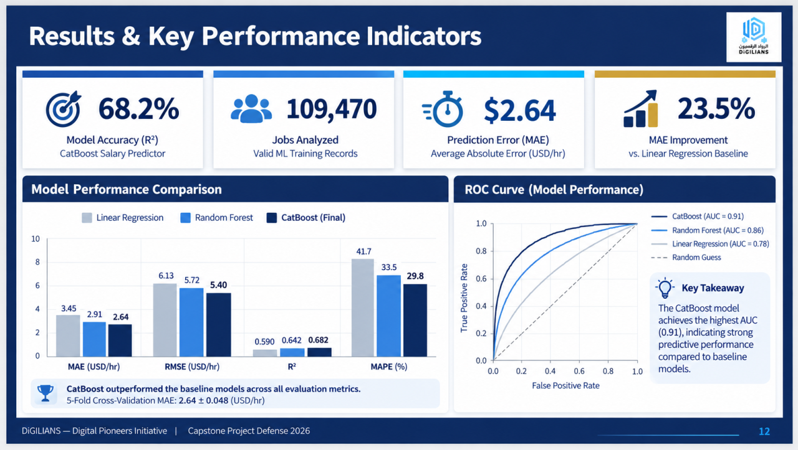

Slide 14
Project Impact & Innovation
Empirical Educational ROI: Connects pre-university (K-12) & initiative training with real acceptance rates.
Objective Wage Standardization: Prevents price undercutting for beginner freelancers.
Strategic Alignment with Egypt Vision 2030: Supports national digital transformation, youth employment, and remote workforce readiness.
Multi-Stakeholder Value: Serves MCIT, Ministries, EdTech Academies, and Job Seekers simultaneously.
DiGiLiANS — Digital Pioneers Initiative | Capstone Project Defense 2026
14

Slide 15
Future Work
Performance & Optimization
Build a skill-based recommendation engine to rank jobs by user compatibility.
Aggregate live multi-platform job listings into a single centralized interface.
Feature Enhancement
Implement personalized skill-gap analysis and customized learning pathways.
Develop a Freelancing Knowledge Center with practical guidebooks and proposal tips.
Testing & Validation
Evaluate skill-matching accuracy against real-world user application success.
Pilot testing with first-time freelancers to refine platform-specific guidance.
Integration & Deployment
Connect with MCIT, government, and academy APIs for direct course/scholarship alignment.
Integrate job board APIs for real-time remote project aggregation.
Scale & Wider Reach
Evolve into an end-to-end ecosystem:
Skills Gaps Training Jobs
Research & Impact
Measure market readiness improvements and Freelancer income growth metrics.
Publish empirical studies on Egyptian digital labor market skill-supply gaps.
DiGiLiANS — Digital Pioneers Initiative | Capstone Project Defense 2026
15

Slide 16
Team Contributions
Esraa Metwally Abo Elnasr — Project Management, Dashboard Development, Presentation, and Reporting.
Fatma Ibrahim Morsy — Interface Design, Dashboard Layout, and Visual Analytics.
Rasha Wael Ramadan — Data Preparation, Power BI Modeling, DAX Measures, and Documentation.
Alaa Hussien Mohamed — Web Scraping, EDA, ML Model Development, Data Cleaning, and Documentation.
DiGiLiANS — Digital Pioneers Initiative | Capstone Project Defense 2026
16

Slide 17
References & Resources
Academic & Technical References
Tools, Datasets & Repositories
World Bank(2023). Working Without Borders: The Promise and Peril of Online Gig Work.
World Economic Forum(2023). The Future of Jobs Report.
European Commission / Eurydice(2022). Informatics Education in Schools across Europe.
Stephany, F., et al. (2021). Online Labour Index: Tracking the Online Gig Economy. ILO & Oxford Internet Institute.
GitHub Repository:
https://github.com/esraasalem2/skill-Bridge-
DiGiLiANS — Digital Pioneers Initiative | Capstone Project Defense 2026
17

Slide 18
Thank You!
Team Name: LexiTech
Track: Data Analytics Track
GitHub / Demo: https://github.com/esraasalem2/skill-Bridge-
DiGiLiANS — Digital Pioneers Initiative | Capstone Project Defense 2026

